Slide 1



Automated Profiling and Resource Management of Pig Programs
for Meeting Service Level Objectives
Zhuoyao Zhang, Ludmila Cherkasova, Abhishek Verma, Boon Thau Loo
University of Pennsylvania
Hewlett-Packard Labs

Slide 2




Unprecedented Data Growth
New York Stock Exchange generates about 1TB of new trade data each day.
Facebook had 10 Billion photos in 2008 (1 PB of storage).
  Now: 100 millions photos uploaded each week
Google
  World wide web, 20 PB processed per day
The Internet Archive stores around 2 PB, and it is growing at 20TB per month

Slide 3
MapReduce, why?
Process Big data with distributed cluster
  Need to process large datasets
  Data may not have strict schema
    i.e., unstructured or semi-structured data
  Nodes fail every day
    Failure is expected, rather than exceptional
MapReduce framework and Hadoop (open source)
offer a scalable and fault-tolerant platform for Big Data processing

Slide 4
Pig – high-level abstraction on Hadoop
MapReduce model is low level and rigid
Pig system – high-level platform on top of Hadoop
  Pig Latin : A high-level language for expressing data analysis programs on Hadoop
  Pig execution environment : Compiles a Pig Latin program into a DAG of MapReduce jobs, and executes them on a given Hadoop cluster
j2
j4
j6
j7
j1
j3
j5

Slide 5
Motivation
Latency-sensitive applications
  Personalized advertising
  Spam and fraud detection
  Real-time log analysis
Meet completion time requirement with appropriate resource allocation
  Deadline-driven resource allocation strategy

Slide 6
Contributions
Pig scheduling optimization
  Optimized scheduling of concurrent jobs
  Reduce the total completion time of the Pig program with optimized execution plan
Performance modeling framework
  Given a Pig program, estimate its completion time as a function of assigned resources
  Given a completion time target, determine the minimal amount of resources for a Pig program to achieve it

Slide 7
Outline
Introduction
Building block
  Performance model for a single MapReduce job [ICAC 11]
Completion time estimates for Pig programs
Deadline-driven resource allocation for Pig programs
Evaluation results
Conclusion

Slide 8
Estimate a single job duration
Most production jobs are executed routinely on new data sets
Measure the job characteristics from the past executions
  E.g., average and maximum task durations
Analytic model based on the upper and lower bounds of job durations computed from the average and maximum task durations (ICAC’2011)

Slide 9
Example
Sequence of tasks: 1 4 3 2 3 1 2
1
Makespan = 4
lower bound
2
3
4
A different execution: 3 1 2 3 2 1 4
1
2
Makespan = 7
upper bound
3
4

Slide 10
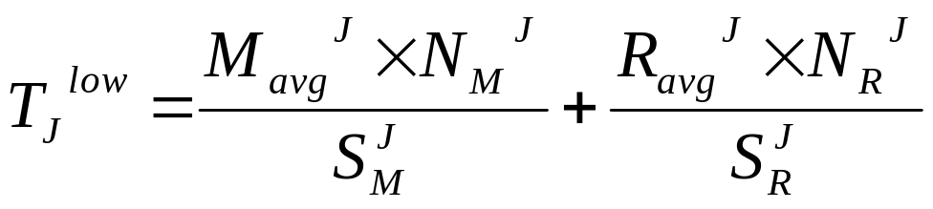
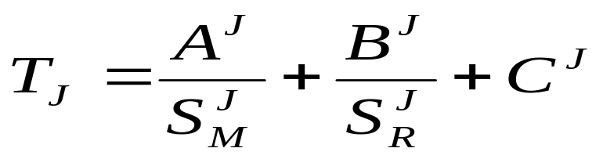
Estimate a single job duration
Example: low bound estimates
  M_{avg}^{J}, R_{avg}^{J}: the average map/reduce task durations
  N_{M}^{J}, N_{R}^{J}: the number of map/reduce tasks
  S_{M}^{J}, S_{R}^{J}: the number of map/reduce slots
General expression
Job characteristics
Resource allocation

Slide 11
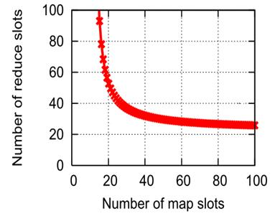
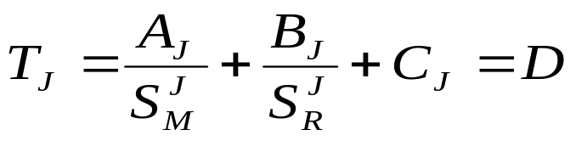
Inverse problem: estimate resource allocation for a single MapReduce job
Given a deadline D and the job profile, find the minimal resource to complete the job within D
Set the job completion time to D in the previous formula
Find the value of S_{M}^{J}, S_{R}^{J} with minimum value of S_{M}^{J}+ S_{R}^{J} using Lagrange's multipliers

Slide 12
Concurrent job execution in a Pig program
Pipelining of map and reduce stages: the total completion time is reduced
Model the concurrent execution
  Job execution order matters !
J₁^{M}
J₁^{R}
J₁
J₂^{M}
J₂^{R}
J₂
J₁^{M}=10s
J₁^{R}=1s
J₂^{M}=1s
J₂^{R}=10s
J₁
J₂
J₂^{M}=1s
J₂^{R}=10s
J₁^{M}=10s
J₁^{R}=1s
J₂
J₁
Inefficient job execution order: 21s
Optimal job execution order: 12s
  Find the optimal execution order with Johnson’s algorithm

Slide 13
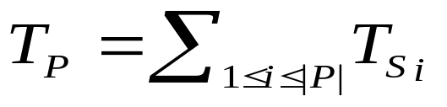
Completion time estimates for Pig Programs
Given a Pig program P, it is translated into a set of stages {S₁, S₂,… S_{|p|}}, where
  each stage contains one or more jobs S_{i} ={j₁, j₂,..j_{N}}
Extract the job profile for each job in the program
Next stage can not start before the finish of previous stage

Slide 14

Completion time estimates for Pig Programs
For stage with single job: T_{s} = T_{j}
For stage with more than one jobs (concurrent execution) :
J₁^{M}
J₁^{R}
J₁
J₂^{M}
J₂^{R}
J₂
J₃^{M}
J₃^{R}
J₃
Stage completion time

Slide 15
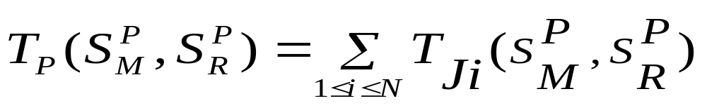
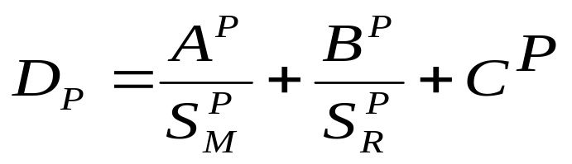
Resource estimates for a Pig program: the basic approach
General idea
  Assume program completion time as the sum of job completion time of all the jobs belong to the program
Use the Lagrange's multipliers to find the minimum pair of ( S_{M}^{P} , S_{R}^{P} ) for the entire Pig program
Pessimistic for programs with concurrent jobs

Slide 16
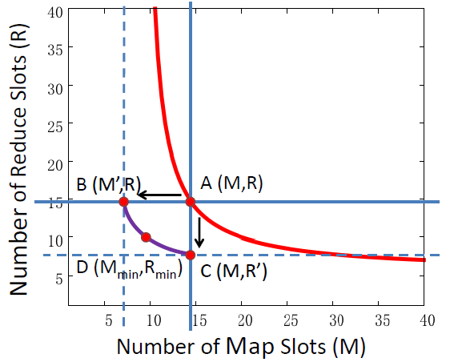
Resource estimates for a Pig program: the refined approach
Upper bound A(M,R):
the minimal resource requirement based on the basic approach
Low Bound B(M’,R):
Get by fixing the reduce slot and step by step reducing the map slots
Low Bound C(M,R’) :
Get by fixing the map slot and reducing the reduce slots
Minimal Requirement D(M_{min}, R_{min}):
Resides on curve between B and C

Slide 17
Experimental setup
Testbed setup
  66 nodes cluster in 2 racks, (1 jobtracker, 1 namenode, 64 worker nodes)
  2 map slots and 1 reduce slot for each node
Workloads
  Pigmix – a benchmark created for testing Pig system performance
  TPC-H – a standard database benchmark for decision-support workloads
  HP Labs’ web proxy query set

Slide 18
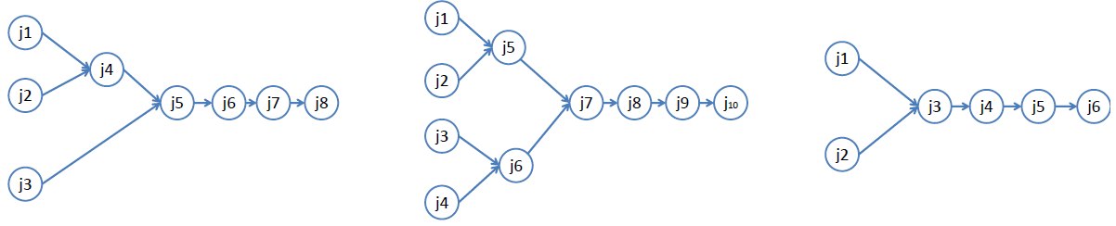
Workloads
PigMix
  Contain 17 Pig programs ( most of them contain sequential jobs )
TPC-H
  Select Q5, Q8, Q10 from 22 queries and express them as Pig programs
HP Labs’ web proxy query set
  3 customized Pig programs
TPC Q5
TPC Q8
TPC Q10

Slide 19
Datasets
Test dataset
  PigMix: 1TB of total data across 8 tables
  TPC-H: around 9GB generated with scaling factor 9 using the standard data generator
  Proxy data: access logs to web proxy gateway for February, March and April 2011 at HP Labs, around 9GB
Experimental dataset
  PigMix: 20% larger than the test dataset
  TPC-H: around 15 GB (scaling factor 15)
  Proxy data: access logs to web proxy gateway for May, June and July at HP Labs, around 9GB

Slide 20
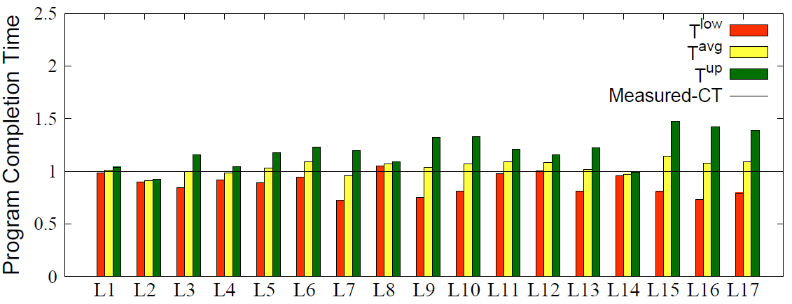
PigMix case study
How well our performance model captures Pig program completion time?
Predicted and measured program completion times with experimental dataset (64 x 64 slots)

Slide 21
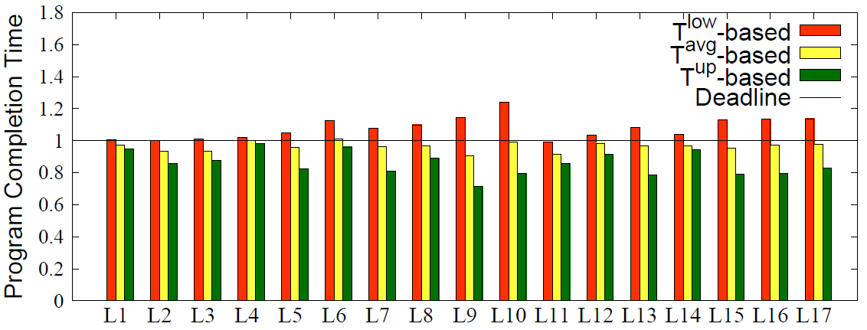
PigMix case study
Can we meet deadlines with our resource allocation?
Program completion times with estimated resource allocations on the experimental dataset

Slide 22
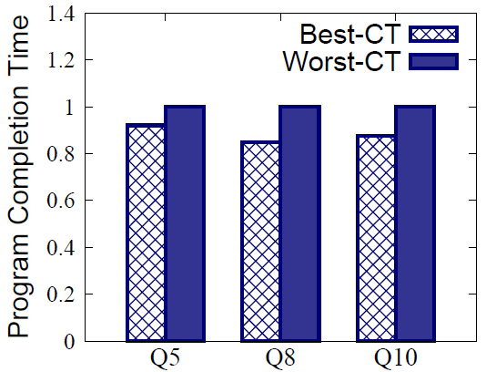
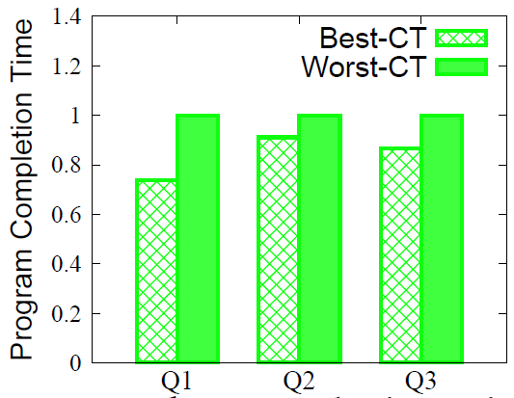
Performance improvements with optimized concurrent job scheduling
Around 20% -30% reduction of program completion time
Program completion time for TPC-H
Program completion time for Proxy queries

Slide 23
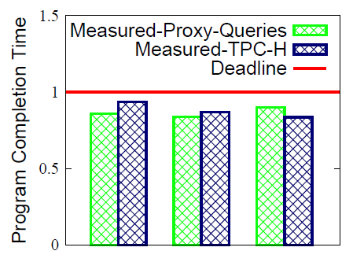
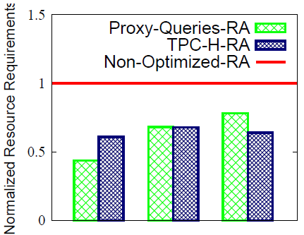
Resource allocation estimates for optimized program execution
Programs complete within deadlines while using 40% ~60% less resources (based on our refined resource allocation estimates)
Can we meet deadlines?
Resource allocations for optimized Pig programs

Slide 24
Conclusion
A novel performance modeling framework for Pig programs with deadlines
  Automated deadline-driven resource provisioning of complex MapReduce workflows
An optimized schedule of concurrent jobs within a Pig program
  Significantly reduced completion time & reduced resource requirements

Slide 25
Thank you

