Slide 1


SLO-Driven Right-sizing and Resource Provisioning of MapReduce Jobs
Abhishek Verma^{1,2}, Lucy Cherkasova², Roy H. Campbell¹
¹University of Illinois at Urbana-Champaign, ²HP Labs

Slide 2






Notes:
New York Stock Exchange generates ~ 1 TB of new trade data/day
Facebook had 10 Billion photos in 2008 (~ 1 PB)
Now: 100 millions photos uploaded each week
Google indexes www (~ 20 PB processed/day)
1 EB of storage under construction
The Internet Archive stores around 2PB
growing at 20TB per month
The Large Hadron Collider (CERN) will produce ~15 PB of data per year.

Slide 3



Large-scale Distributed Computing
…
. . .
How to program
this monster?
…
…
…
DATA
. . .
…
Large data centers (x1000 machines): storage and computation
MapReduce and Hadoop (open source) come to rescue
  Key technology for search (Bing, Google, Yahoo)
  Web data analysis, user log analysis, relevance studies, etc.

Slide 4
MapReduce, Why?
Need to process very large datasets
Data may not have strict schema
  Unstructured or semi-structured
Nodes fail every day
  Failure is the norm, rather than exception
  Number of nodes not constant
Expensive and inefficient to build reliability in each application

Slide 5

Hadoop operation
Job
Scheduler
Task
Task
Task
MapReduce
Layer
Location
Information
JobTracker
TaskTracker
TaskTracker
File system
Layer
NameNode
DataNode
DataNode
...
Disk
Disk
Master
Worker Node
Worker Node

Slide 6
Motivation
MapReduce clusters shared
  Multiple users and applications
Time critical applications
  Personalized advertising, spam detection, real-time event log analysis, …
Key challenge: controlling allocation of resources in shared deadline MapReduce environments
  FIFO, Fair Scheduler, Capacity Scheduler
  No support from existing schedulers

Slide 7
Problem Definition
To achieve Service Level Objectives (SLO)
  Completion time estimation
  Resource allocation to achieve deadlines
  Smaller input datasets to predict performance

Slide 8
Outline
Motivation
Approach
Job Profile
Scaling Factors
Evaluation

Slide 9
Our Approach
Most production jobs are executed routinely on new data sets
Measure the job characteristics of past executions
  Each map and reduce task is independent of other tasks
  Compactly summarize them in a job profile
Estimate the bounds of the job completion time (instead of trying to predict the exact job duration)
  Estimate bounds on the duration of map, shuffle/sort, and reduce phases

Slide 10
Caveats
“All models are wrong, some models are useful”
--- George Box
Map and Reduce task durations only depend on input dataset size
Jobs have been executed previously
  Or can be profiled on smaller dataset

Slide 11
Illustration
Sequence of tasks: 1 4 3 2 3 1 2
1
Makespan = 4
2
3
4
A different permutation: 3 1 2 3 2 1 4
1
2
Makespan = 7
3
4

Slide 12
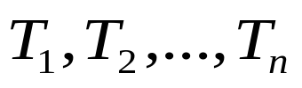



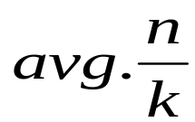
Formalizing Makespan Bounds
Distributed task processing
  assign each task to the slot with the earliest finishing time
Let be the duration of tasks processed by
  be the average duration and
  be the maximum duration of the tasks
Then the execution makespan can be approximated as
  Lower bound is
  Upper bound is

Slide 13
Compact Job Profile

Slide 14
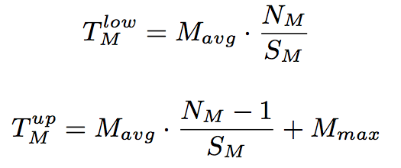
Lower & Upper Bounds of Job Completion Time
Two main stages: map and reduce stages
Map stage duration depends on:
  N_{M} -- the number of map tasks
  S_{M} -- the number of map slots
Reduce stage duration depends on:
  N_{R} -- the number of reduce tasks
  S_{R} -- the number of reduce slots
Reduce stage consists of :
  Shuffle/sort phase
    “First” wave is treated specially (non-overlapping part with maps)
    Remaining waves are “typical”
  Reduce phase
More details in the paper
Notes:
Change latex Nm/Sm

Slide 15

Solving the inverse problem
Given a deadline time T and the job profile, find the necessary amount of resources to complete the job within T.
Given number of map/reduce tasks
Find the number of map and reduce slots (S_{M}, S_{R})

Slide 16
Scaling Factors
Build profile by executing on smaller dataset
Duration of map tasks not impacted
  Larger data => greater number of map tasks
  Each map task processes fixed amount of data
If number of reduce tasks kept constant,
  Intermediate data processed per reduce task increases => longer durations
Reduce stage = shuffle + reduce phase
Shuffle duration depends on network performance
Reduce duration depends on reduce function and disk write speed

Slide 17
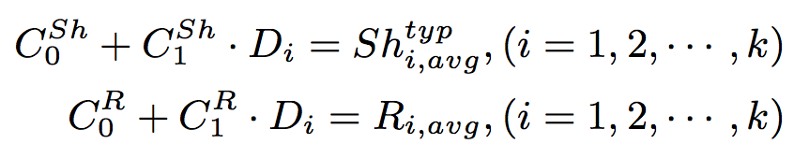
Scaling Factors Formalized
Perform k (> 2) experiments varying input dataset size
D_{i} = amount of intermediate data
Use linear regression to derive scaling factors
  For shuffle and reduce phases separately
  Per application

Slide 18
Experimental Setup
66 HP DL145 machines
  Four 2.39 GHz cores
  8 GB RAM
  Two 160 GB hard disks
Two racks
  Gigabit Ethernet
2 masters + 64 slaves
Workload
  WordCount, Sort, Twitter, WikiTrends

Slide 19
Predicted vs Measured completion times
Measured completion time is within 10% of average predicted time

Slide 20
WordCount Scaling Factors
Linear regression fits phase durations with R² > 95%

Slide 21
Predictions applying scaling factors
Scaling factors maintain accuracy of predictions

Slide 22
SLO based resource provisioning

Slide 23
Conclusion
Performance model and job profiling tools
  Enable automated workload management of MapReduce jobs with timing requirements
ARIA: Automatic Resource Inference and Allocation
Future Work
  Handle node failures and network bottlenecks
  Comparison of different SLO-driven schedulers
    Difficult effort: requires implementing schedulers
    Running experiments take hours/days
  Good simulation environment is needed
    With trace replay capabilities
    Synthetic and real workload generator

Slide 24
Questions?
verma7@illinois.edu

Slide 25
Related Work
Polo et. al. [NOMS10] estimate progress of map stage alone
Ganapathi et. al. [SMDB10] use KCCA for hive queries
Starfish [CIDR11, VLDB11]
ARIA [ICAC11]
Tian and Chen [Cloud11]

