Slide 1


Two Sides of a Coin:
Optimizing the Schedule of MapReduce Jobs
Abhishek Verma, Lucy Cherkasova, Roy H. Campbell

Slide 2





Big Data is here to stay
Notes:
Exabytes of data generated and processed
Web companies: Google, Microsoft, Facebook
Organizations: NYSE, CERN,
Supply chain optimization: Target, Walmart

Slide 3
MapReduce Background
Need to process large datasets
Data may not have strict schema:
  i.e., unstructured or semi-structured data
Nodes fail every day
  Failure is expected, rather than exceptional.
  The number of nodes in a cluster is not constant.
Expensive and inefficient to build reliability in each application

Slide 4
Motivation
Reduce stage has to wait for map stage to complete
Reduce stage of first job can overlap with the map stage of subsequent job
Key challenge:
  Minimize makespan (overall completion time) of a set of jobs
  Increase cluster utilization

Slide 5
Problem Definition
Order of MR jobs can affect makespan
Given a set of MapReduce jobs, determine the order in which they should be executed to minimize the Makespan.
Makespan = 42
Makespan = 42
20
2
20
J₁:
J₂:
2
Makespan = 24
20
2
20
J₁:
J₂:
2

Slide 6
Outline
Motivation
Johnson’s Algorithm
Estimating Stage durations
Balanced Pool Algorithm
Evaluation

Slide 7
Johnson’s Algorithm
In 1953, Johnson proposed an algorithm for two stage production assembly:
  Given two machines and n jobs, each must pass through machine 1 and then machine 2.
  Each machine can process only one job at a time.
Sort list of jobs by their service times on either machines
Iterate through the list: If service time is for the first machine, put the job towards the beginning, else put it towards the end continuing towards the middle
Optimal makespan schedule in O(n log n)

Slide 8
Johnson’s Algorithm
J_{i} | M_{i} | R_{i} | D_{i}
J1 | 4 | 5 | (4, map)
J2 | 1 | 4 | (1, map)
J3 | 30 | 4 | (4, red)
J4 | 6 | 30 | (6, map)
J5 | 2 | 3 | (2, map)
J_{i} | M_{i} | R_{i}
J1 | 4 | 5
J2 | 1 | 4
J3 | 30 | 4
J4 | 6 | 30
J5 | 2 | 3
J_{i} | M_{i} | R_{i} | D_{i}
J2 | 1 | 4 | (1, map)
J5 | 2 | 3 | (2, map)
J1 | 4 | 5 | (4, map)
J3 | 30 | 4 | (4, red)
J4 | 6 | 30 | (6, map)
Schedule:
J2
J5
J1
J4
J3

Slide 9
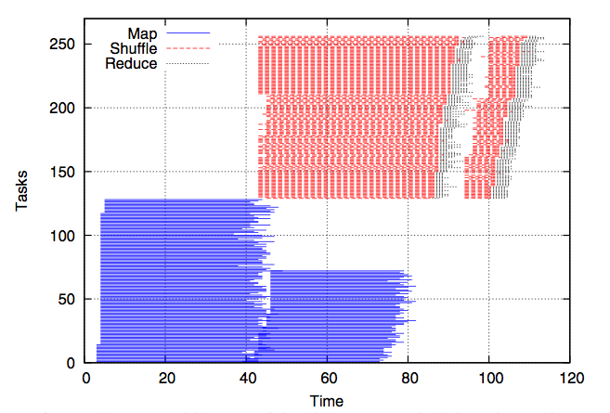
Challenges
MapReduce jobs consist of multiple tasks
Map and reduce stages overlap
Reduce stage
Map stage

Slide 10
Estimating Stage Durations
Most production jobs are executed routinely on new data sets
Measure the job characteristics of past executions
  Each map and reduce task is independent of other tasks
Estimate the upper and lower bounds on stage durations from the average and maximum task duration
Overlap of Map and Reduce stages
  Account only the non-overlapping portion as Reduce stage duration

Slide 11
Example
Sequence of tasks: 1 4 3 2 3 1 2
1
Makespan = 4
2
3
4
A different permutation: 3 1 2 3 2 1 4
1
2
Makespan = 7
3
4

Slide 12
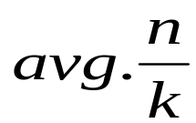
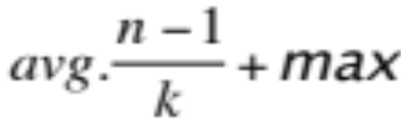
Formalizing Stage Duration Bounds
Distributed task processing
  assign each task to the slot with the earliest finishing time
Let T₁, T₂, …, T_{n} be the duration of n tasks processed by k slots
  avg be the average duration and
  max be the maximum duration of the tasks
Execution makespan can be approximated as
  Lower bound is
  Upper bound is
Notes:
avg on the other side, k slots

Slide 13
Limitations of Johnson’s Algorithm
Abstracting stages as a single atomic unit, we can apply Johnson’s algorithm to find a permutation
But stages consist of multiple tasks
Balancing tasks over multiple machines is NP-Hard (3-partition)
Using Johnson’s algorithm can lead to sub-optimal solutions

Slide 14
Example of sub-optimal schedule
Stage duration
Number
of slots
Map Stage
Reduce Stage
J₂:
1
4
J₅:
2
3
J₁:
4
5
J₄:
6
30
J₃:
30
4
30
0
10
20
30
40
Time

Slide 15
Improved Schedule
J₂:
1x3
4x3
J₅:
Pool 1
2x3
3x3
J₁:
4x3
5x3
J₄:
6
30
Pool 2
J₃:
30
4
30
0
10
20
30
40
Time

Slide 16
Balanced Pools Algorithm
Sort jobs by increasing number of tasks
Split them into a set of small and large jobs
Binary search for the pool size that balances completion time of both pools.
O(n² log n log M) where n is the number of jobs and M is the number of machines

Slide 17
Experimental Setup
Simulation environment: SimMR
Yahoo M45 workload
  100 jobs: N(154, 558) map and N(19, 145) reduce tasks
  N(50, 200) and N(100, 300) map and reduce task durations
  Unimodal: scaled using [1, 10]
  Bimodal: 80% jobs scaled using [1, 2] and 20% jobs using [8, 10]
Synthetic workload
  100 jobs: [1, 100] map and[1, 50] reduce tasks
  N(100, 1000) and N(200, 2000) map and reduce task durations
  Unimodal: scaled using [1, 10]
  Bimodal: 80% jobs scaled using [1, 2] and 20% jobs using [8, 10]

Slide 18
Synthetic Workload

Slide 19
Yahoo M45 Workload

Slide 20
Conclusion
Minimizing makespan and increasing cluster utilization are two sides of the same coin
Designed balanced pools heuristic yields 15-38% makespan improvements
Future work
  Minimize makespan for a DAG of MapReduce jobs

Slide 21
References

